Slide 1


PROJECT B.A.T.
A Google Earth Pro To Minecraft
Blueprint Automation Tool
Kevin Green
B.S. Computer Science
1

Slide 2


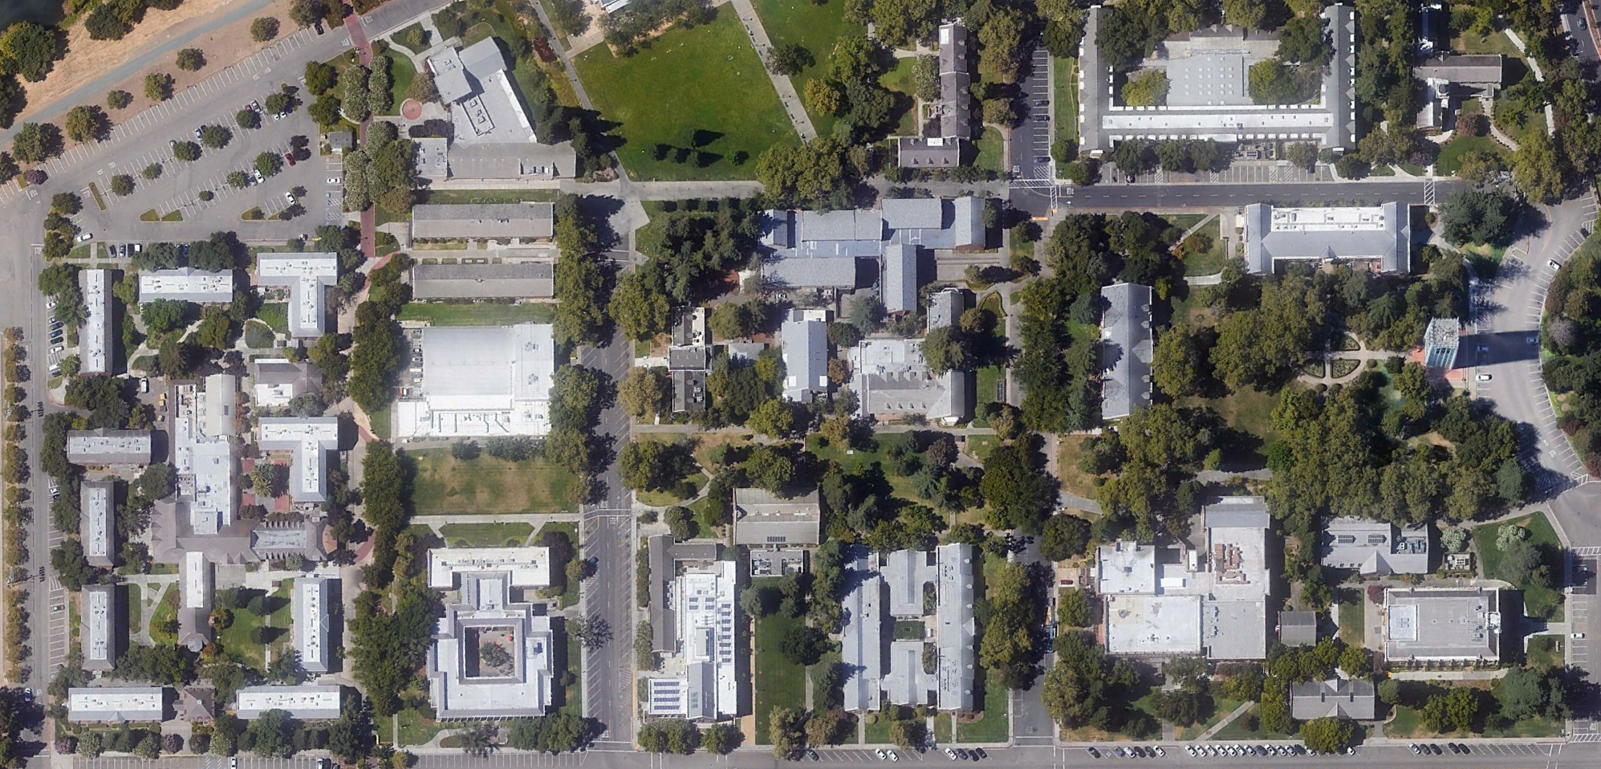
INTRODUCTION
Recreating Real Places
Recreate Real Places in Minecraft
Creative Challenge For Players
Done To Scale
Important But Tedious Planning Phase
Steps Required
Google Earth Measurements
Coordinate Conversions
Creation of Place Blueprints
Main Problems
Can Take Long Time
Repetitive and Tedious
Project B.A.T.
Automates Calculations
Automates Blueprint Creation
2
Notes:
Introduction – Describe the general problem area or research question that your project addresses

Slide 3




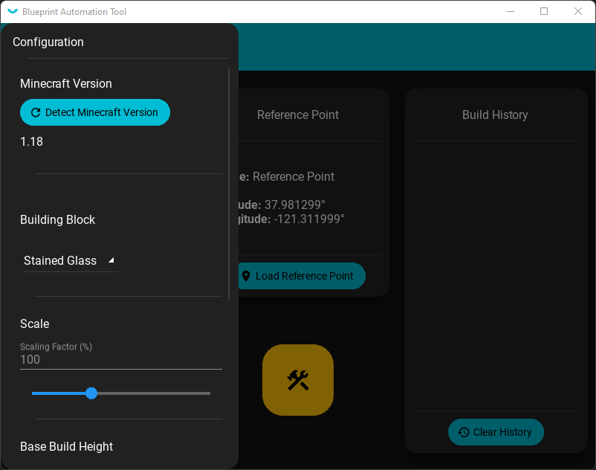
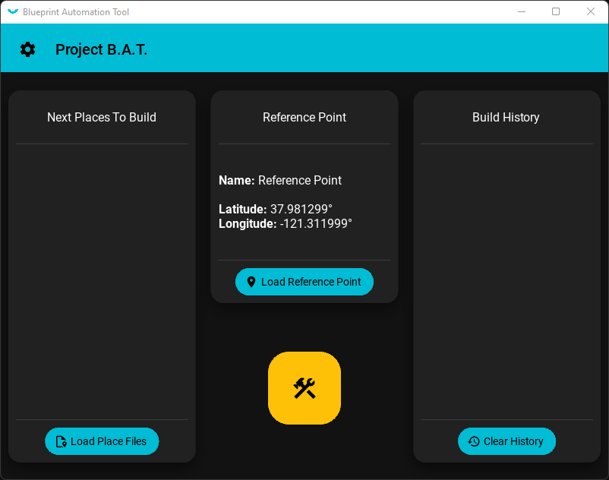
IMPLEMENTATION
Settings
Automation
Interface
Changes Behavior / Looks
Building Block Choices
Scale Of Generated Builds
Base Building Height
Automatic Measurements
Automatic Conversions
Automatic Blueprint Builds
Stability & Error Checks
Material Design Interface
Plug-And-Play Design
Main Automation Menu
Configurable Settings Menu
3
Notes:
Implementation – Describe the application you developed. Do not plan to give a demo of your application (there will not be enough time). Instead, you might want to provide 2-3 screenshots or animated GIF that illustrate the primary functionality of your application. Do NOT embed video or link to YouTube. Make sure it is clear how your application solves the problem or answers the research question you mentioned earlier.

Slide 4



CONCLUSION
Summary
What To Expect
The Problem
Project B.A.T.’s Solution
Major Features Implemented
Minecraft Automation
User-Controlled Settings
User Interface
Live Demonstrations Of Game Automation
Recreation Of University Buildings Outlines
Item 3
2
Notes:
Introduction – Describe the general problem area or research question that your project addresses

Slide 5
PROJECT B.A.T.
Thank You!
5

